Slide 1

Extract, Transform, and Load
(ETL)
Presented by: Abdulrahman Mohammed
Presented to: Big Data Team
Team Lead: Mohamed Emad El-Dien
Supervised By : Zeyad Taher

Slide 2
Extract, Transform, and Load (ETL)
An Overview of ETL Processes and Evolution

Slide 3
What is ETL?
It is the process of integrating data from multiple sources into a central data warehouse.
Cleans and organizes raw data for storage, analytics, and machine learning (ML).
Enables business intelligence by generating reports, dashboards, and predicting outcomes.

Slide 4
Why is ETL important?
Data Sources in Organizations:
Organizations handle structured and unstructured data from various sources.
Common data sources include:
CRM systems
Vendor systems
IoT devices
Social media
HR systems.

Slide 5
Role of ETL
Since all this data is in different formats and systems, ETL helps standardize it for analysis.

Slide 6
How does ETL benefit business intelligence?
ETL improves business intelligence by making the process more reliable, accurate, detailed, and efficient.
Historical Context: Combines legacy and new data for long-term analysis.
Consolidated Data View: Integrates multiple datasets for improved efficiency.
Accurate Data Analysis: Ensures data quality and compliance.
Task Automation: Reduces manual processing efforts.

Slide 7
Improve decision-making – Example: Online retailers can analyze past sales to forecast demand and prevent stock shortages.
Enhance customer insights – Example: Marketing teams can combine CRM data with social media feedback to understand customer behavior and improve advertising strategies.
Optimize operations – Example: A logistics company can analyze sensor data from delivery trucks to reduce fuel costs.

Slide 8
How does ETL work?
ETL follows three key steps:
Extract: Pull data from various sources into a staging area.
Transform: Clean, standardize, and apply business rules.
Load: Move transformed data to the target system.

Slide 9
What is data extraction?
Update Notification: Source notifies when data changes.
Incremental Extraction: Periodically extracts modified data.
Full Extraction: Reloads all data when change tracking is unavailable.

Slide 10
What is data transformation?
Basic: Cleansing, deduplication, format standardization.
Advanced: Business rules, joining, splitting, summarization, encryption.

Slide 11
What is data loading?
Full Load: Transfers entire dataset initially.
Incremental Load: Updates only changed data.
Streaming Load: Continuous small data updates.
Batch Load: Periodic updates for large data volumes.

Slide 12
What is ELT?
Extract, Load, and Transform (ELT) reverses the ETL process by loading raw data first and transforming it within the data warehouse. ELT is more suited for cloud-based and big data applications.

Slide 13
ETL vs ELT
ETL: Defines structure and relationships before loading; ideal for legacy systems.
ELT: Loads raw data first and transforms it later; preferred for modern cloud-based analytics.

Slide 14
Common ETL Tools
• Enterprise: Informatica PowerCenter, Microsoft SSIS, Talend.
• Cloud: AWS Glue, Google Dataflow, Azure Data Factory.
• Open-Source: Apache Nifi, Airbyte, Apache Spark.

Slide 15
Best Practices for ETL
• Optimize extraction with indexing and partitioning.
• Improve transformation with parallel processing.
• Efficient loading via bulk inserts.
• Automate with Airflow.
• Ensure scalability using cloud-based ETL.

Slide 16
What is a Data Warehouse?
Aggregates data from multiple sources into a single, central, and consistent store
Supports data analytics, business intelligence (BI), data mining, machine learning (ML), and artificial intelligence (AI)
Can handle structured, semi-structured, and unstructured data
Feeds data from systems like CRM, inventory, POS, and supply chain management
Traditionally on-premises but now widely hosted in the cloud

Slide 17
Evolution of the Data Warehouse
1980s: Developed to integrate transactional data for analytics
New data sources: Web, social media, IoT led to increased demand
Legacy systems limitations: Couldn’t manage large workloads or unstructured data
Modern solutions: Cloud-native warehouses & data lakehouses emerged

Slide 18
Schemas in Data Warehouses
-Star Schema
-Snowflake Schema

Slide 19
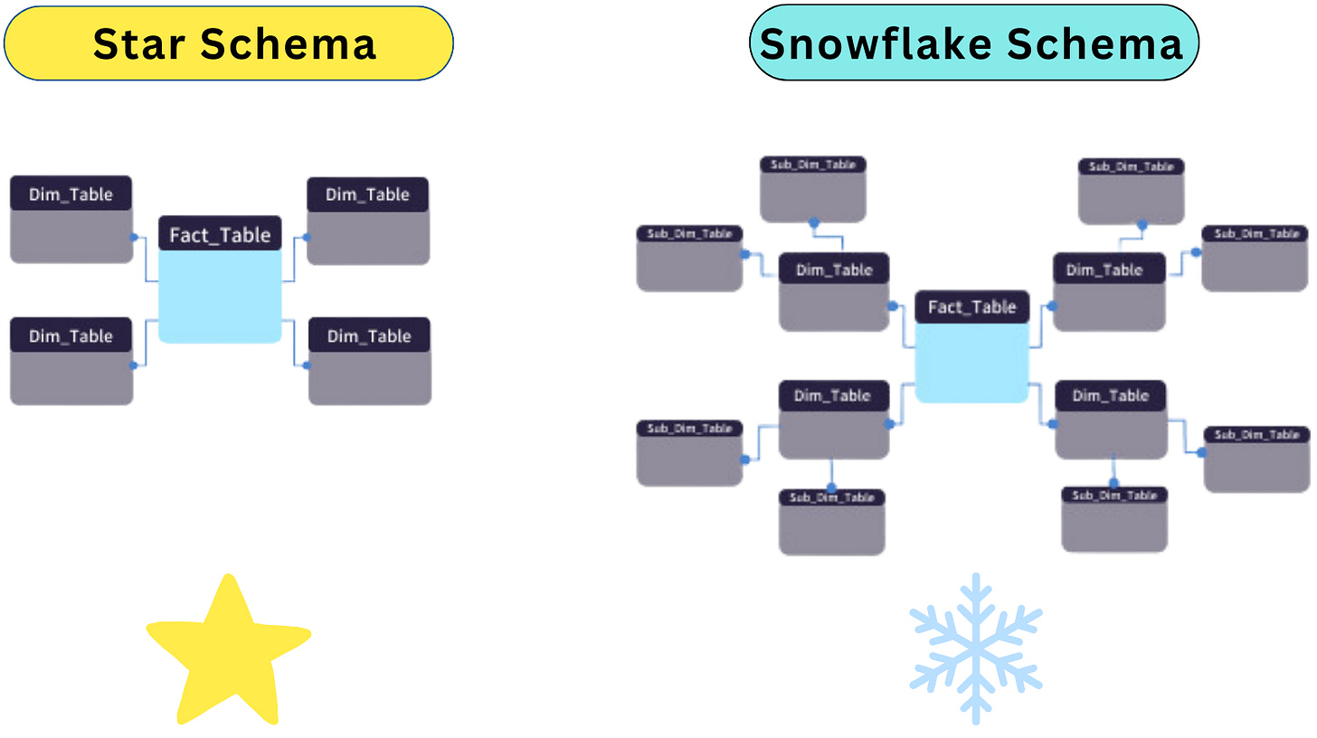

Slide 20
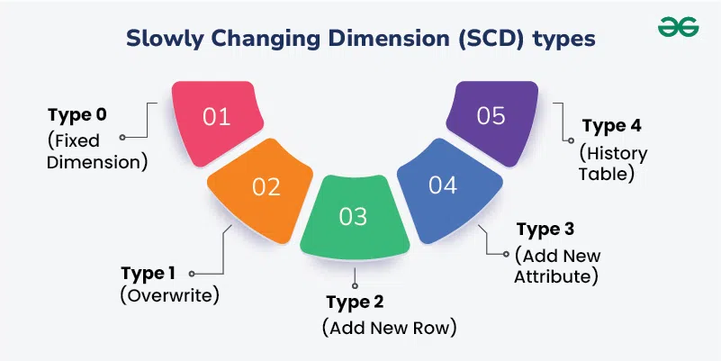

Slide 21
Project Overview
Project Name: E-Commerce Data Warehousing Solution
Purpose: Design and implement a scalable data warehouse for analytics and reporting.
ETL Tool Used: Informatica.
Schema Design: snowflake Schema (Fact and Dimension Tables).

Slide 22
Business Needs
When is the peak season of our e-commerce?
What time users are most likely make an order or using the ecommerce app?
What is the preferred way to pay in the ecommerce?
How many installment is usually done when paying in the ecommerce?
What is the frequency of purchase on each state?

Slide 23
Which logistic route that has heavy traffic in our e-commerce?
How many late deliveries have been made in our e-commerce? Are late orders affecting customer satisfaction?
How long are the delays for the delivery/shipping process in each state?
How long are the difference between estimated delivery time and actual delivery time in each state?

Slide 24


Slide 25
Solution Approach
1- Data Warehouse Model:
Design a snowflake schema with fact and dimension tables to store and analyze structured data.
Key Tables:
Fact Tables: Order
Dimension Tables: User, Seller, Product, Feedback, Payment, Order Item, Time, Date.
2-ETL pipelines for staging layer
3-ETL pipelines for the Data warehouse layer

Slide 26
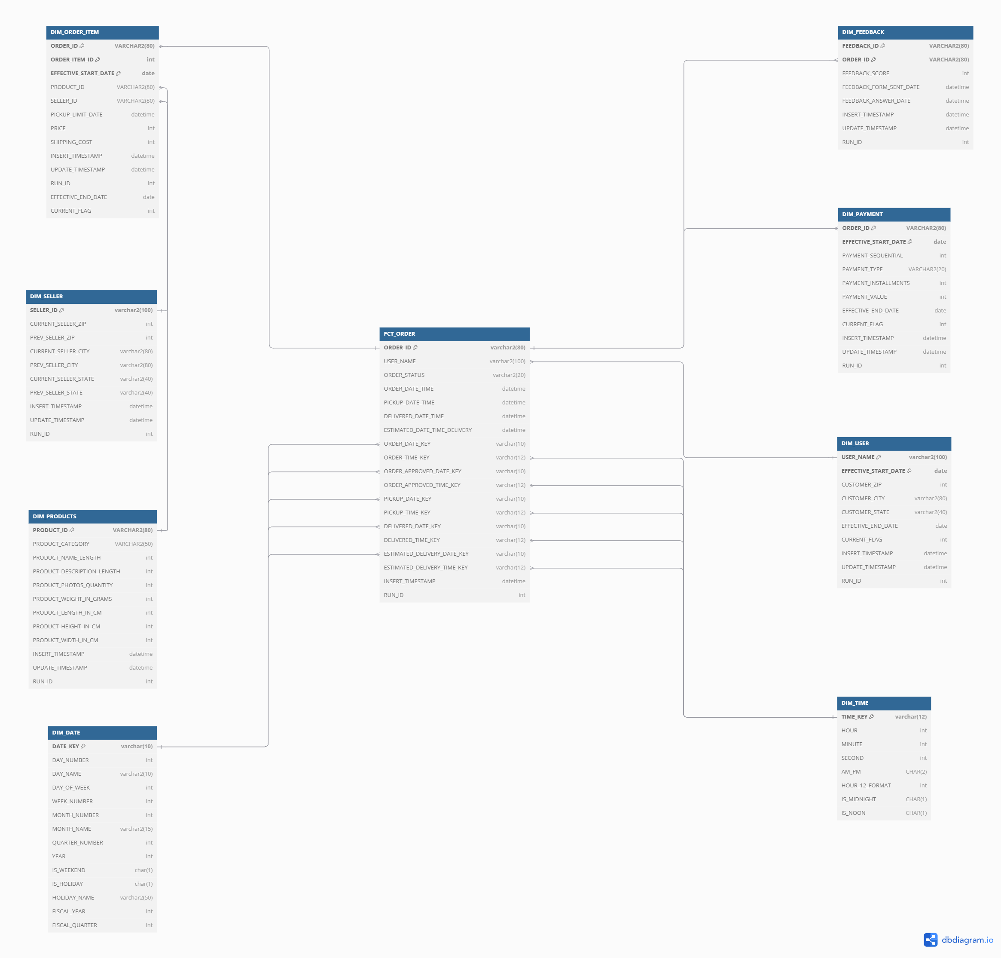

Slide 27
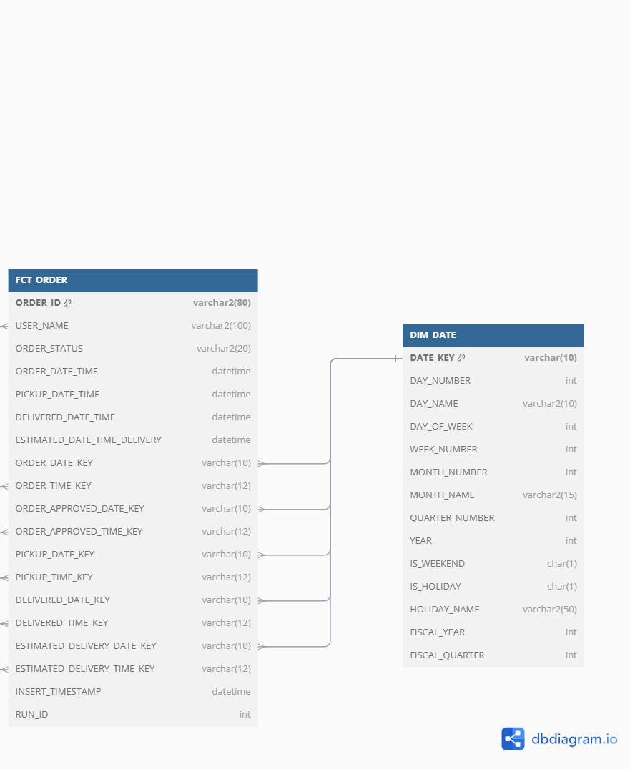
Why this model supports business needs
1. When is the peak season of our e-commerce?
Data Sources:
FCT_ORDER
DIM_DATE.
.

Slide 28
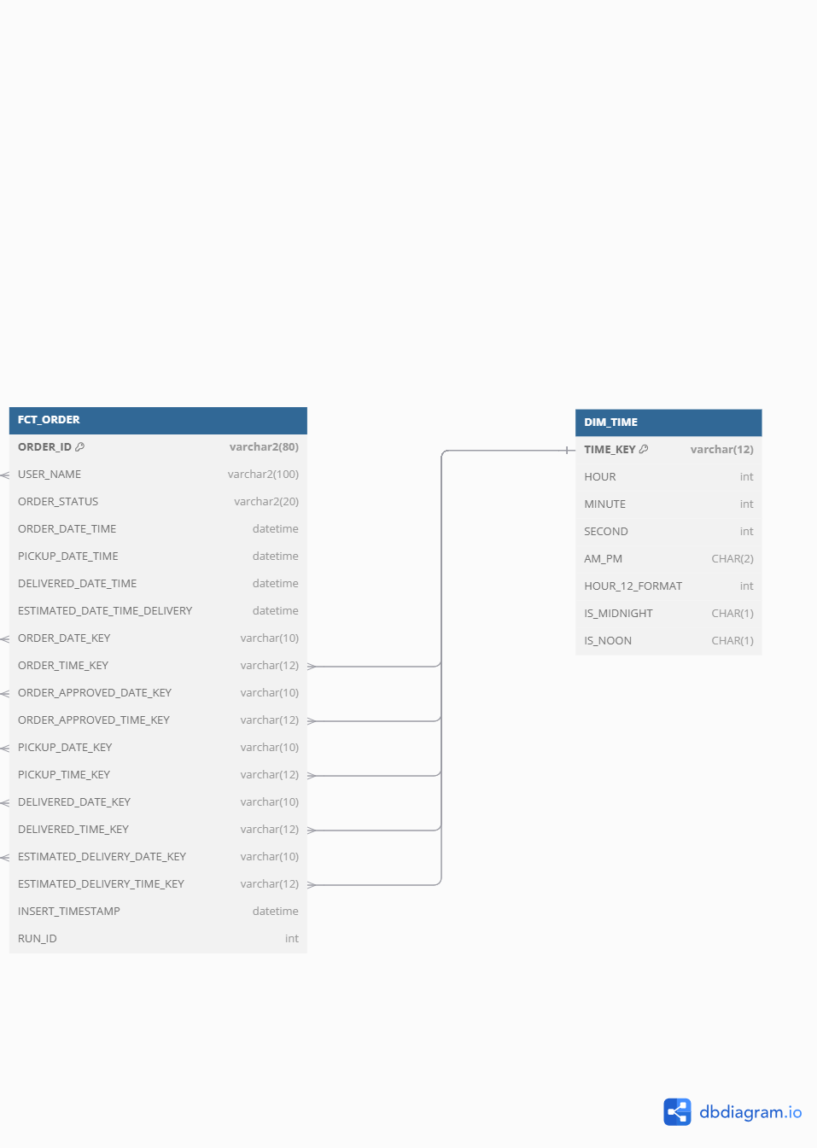
2. What time users are most likely to make an order or use the e-commerce app? Data Sources: FCT_ORDER DIM_TIME

Slide 29
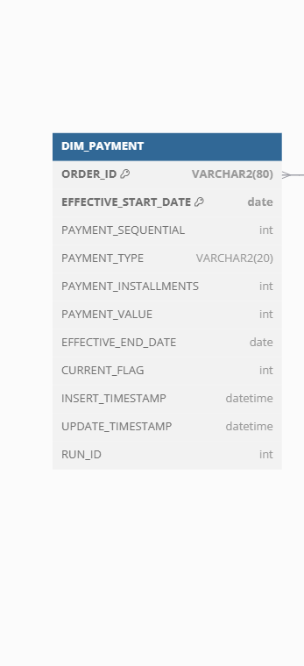
3. What is the preferred way to pay in e-commerce?
Data Sources:
DIM_PAYMENT
4. How many installments are usually done when paying in e-commerce?
Data Sources:
DIM_PAYMENT

Slide 30
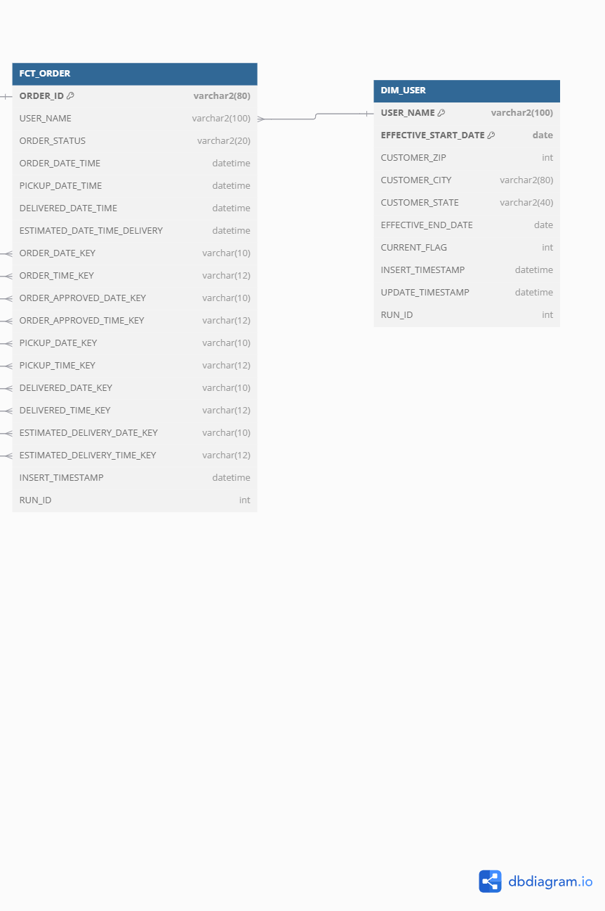
5. What is the frequency of purchase in each state?
Data Sources:
DIM_USER.
FCT_ORDER (linked to users through USER_NAME)

Slide 31
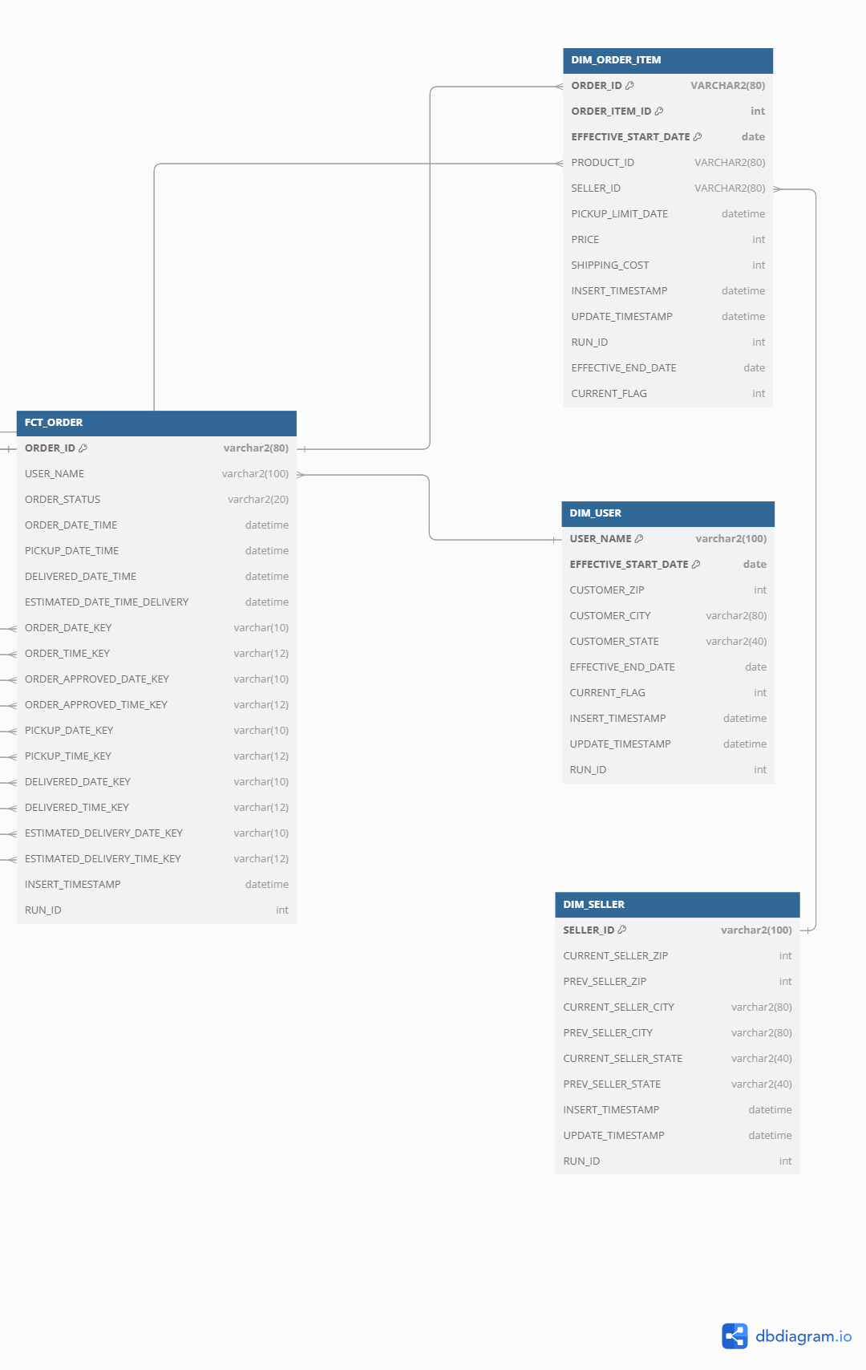
6. Which logistic route has heavy traffic in our e-commerce? Data Sources: FCT_ORDER DIM_USER DIM_SELLER DIM_ORDER_ITEM.

Slide 32
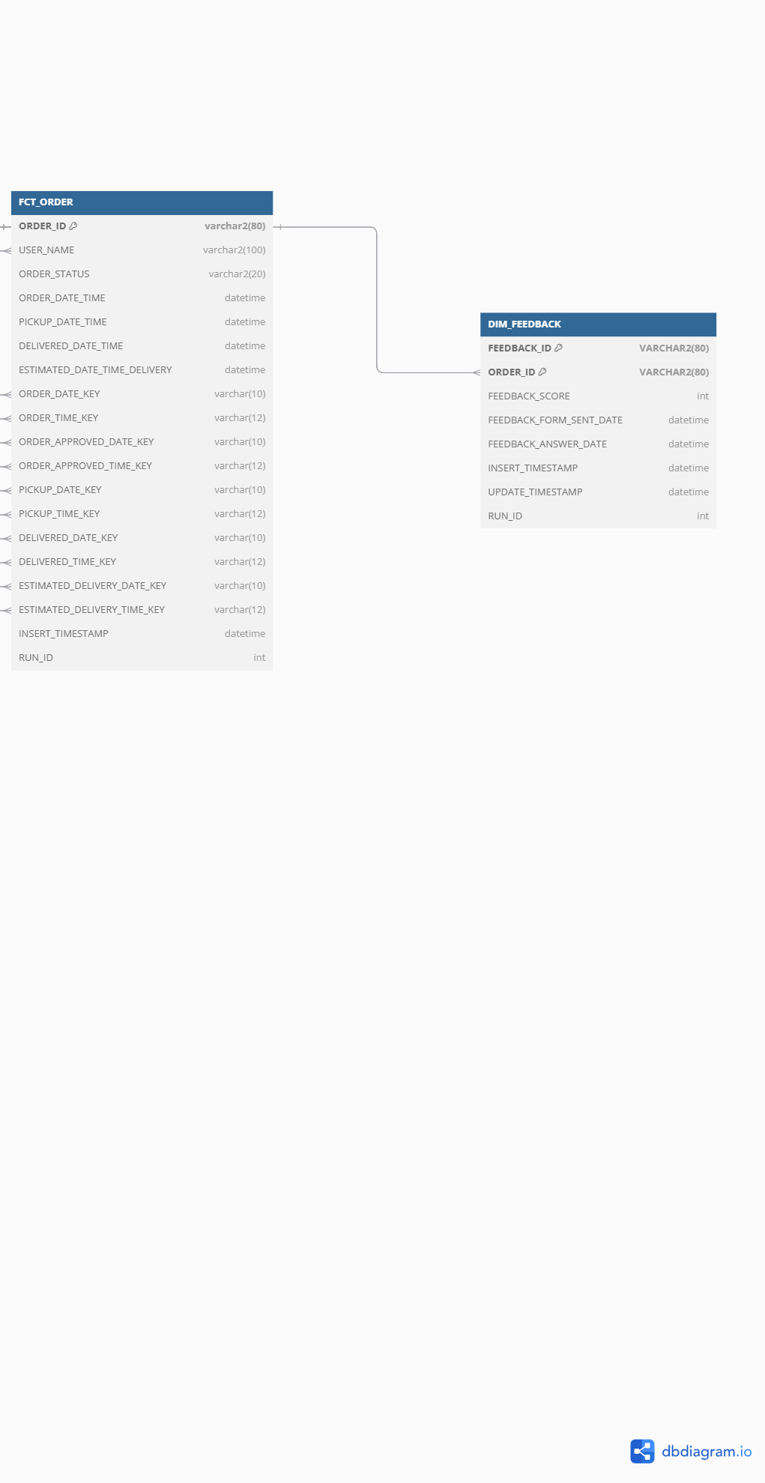
7. How many late delivered orders are in our e-commerce? Are late orders affecting customer satisfaction?
Data Sources:
FCT_ORDER.
DIM_FEEDBACK.

Slide 33
ETL pipelines for staging layer
Staging Layer Workflow in This Project:
In this project, the staging layer was designed to load data from flat files into temporary staging tables in Oracle before transforming and loading it into the Data Warehouse. The ETL process was implemented using Informatica, ensuring smooth data movement from sources to targets.

Slide 34
Steps in Staging Layer Implementation
Data Extraction
Data was extracted from seven flat files containing raw e-commerce transactions.
Informatica mappings were created to read the flat file data.
Data Loading to Staging Tables
Each flat file was mapped to a corresponding staging table in Oracle.
No transformations were applied at this stage, ensuring a raw replica of the source.
Data Transformation
Basic formatting (e.g., date and number conversions) was applied.

Slide 35
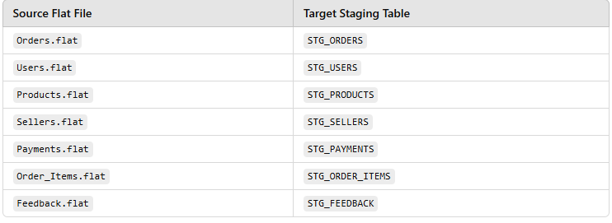
6. Staging Layer Mapping Example in Informatica
For each file, an Informatica mapping was created, reading from the source flat file and loading into an Oracle staging table.

Slide 36
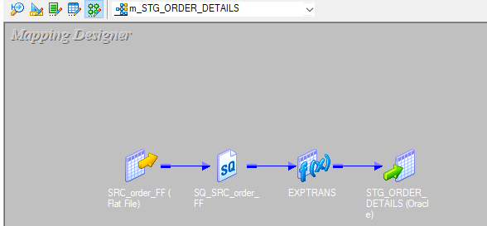
1. Mapping Overview (ORDER)
Mapping Name: [m_STG_ORDER_DETAILS]
Source File: [SRC_order_FF)]
Target Table: [STG_ORDER_DETAILS]
Description: [DATA IS LOADED FROM SOURCE FILE TO STAGING TABLE]

Slide 37
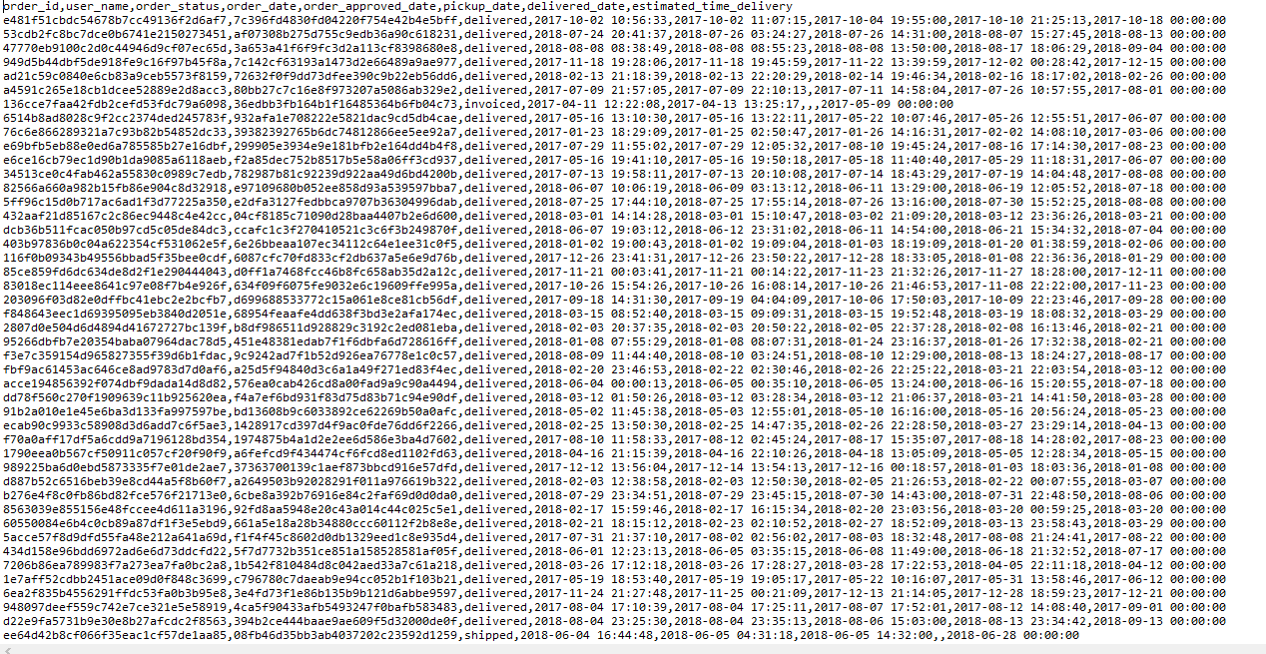
2. Source File Details
File Name: [SRC_order_FF]
File Type: [CSV]
Delimiter: [Comma]

Slide 38
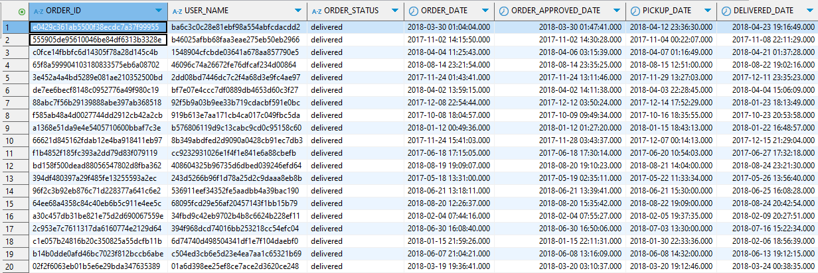
3. Target (Staging Table) Details
Table Name: [STG_ORDER_DETAILS]
DATABASE:[ORACLE]

Slide 39
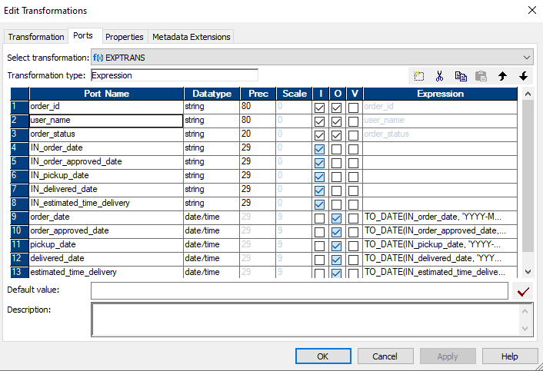
Transformations Applied:

Slide 40
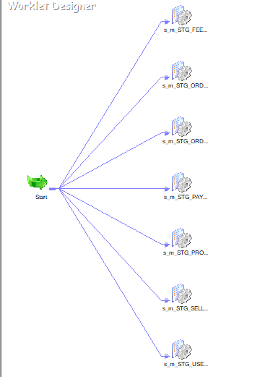

Slide 41
ETL pipelines for the Data warehouse layer
ETL Process for My Data Warehouse
Extraction: Data is pulled from staging tables.
Transformation: Business rules are applied
Loading: Transformed data is inserted into warehouse tables

Slide 42
2. Data Warehouse Schema Design
This project follows a snowflake schema structure:
One Fact Table (FCT_ORDER) → Captures order lifecycle events.
Six Dimension Tables:
DIM_USER → Stores customer details.
DIM_SELLER → Stores seller information.
DIM_PRODUCT → Stores product details.
DIM_PAYMENT → Stores payment methods and installment details.
DIM_FEEDBACK → Stores customer feedback on orders.
DIM_ORDER_ITEM → Captures details of items within each order.
Supporting Time & Date Dimensions:
DIM_DATE → Enables date-based analysis.
DIM_TIME → Enables time-based events.

Slide 43
Data Warehouse Mapping Examples
Example 1: DIM_FEEDBACK – Slowly Changing Dimension Type 1
Example 2: DIM_PAYMENT – Slowly Changing Dimension Type 2
Example 3: DIM_SELLER – Slowly Changing Dimension Type 3

Slide 44
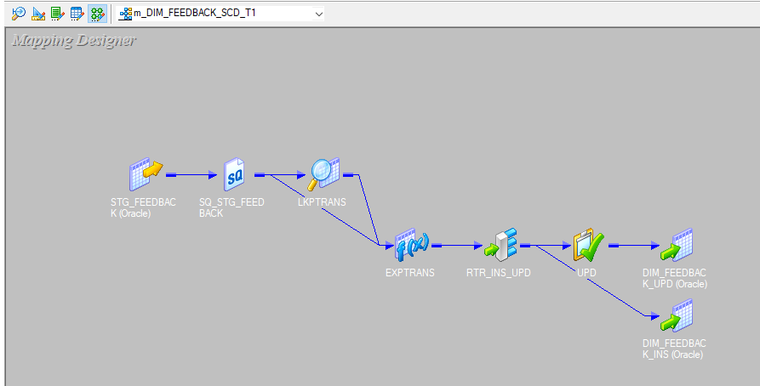
1. Mapping Overview(DIM_FEEDBACK)
Mapping Name: [m_DIM_FEEDBACK_SCD_T1]
Source Table: [STG_FEEDBACK]
Target Table: [DIM_FEEDBACK]

Slide 45
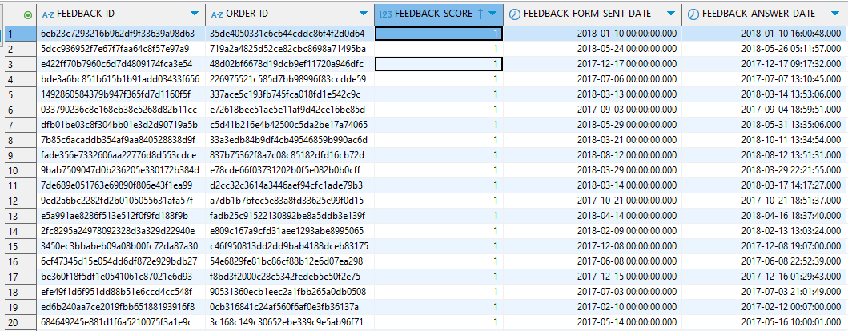
2. Source (Staging Table) Details
Table Name: [STG_FEEDBACK]

Slide 46
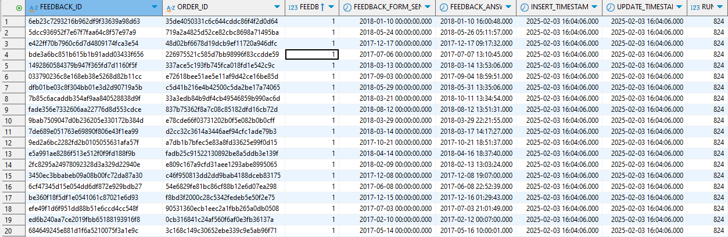
3. Target (Data Warehouse Table) Details
Table Name: [DIM_FEEDBACK]
Table Type: [Dimension]

Slide 47
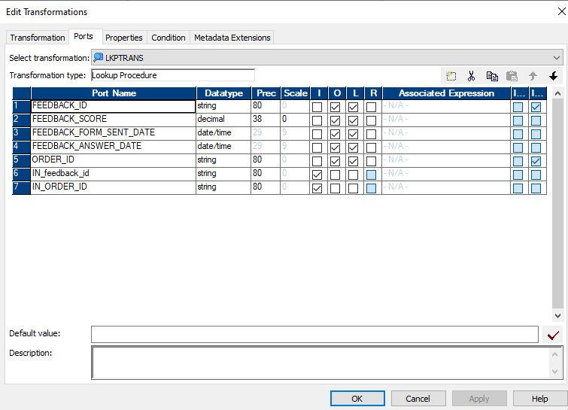
Lookup Transformation

Slide 48
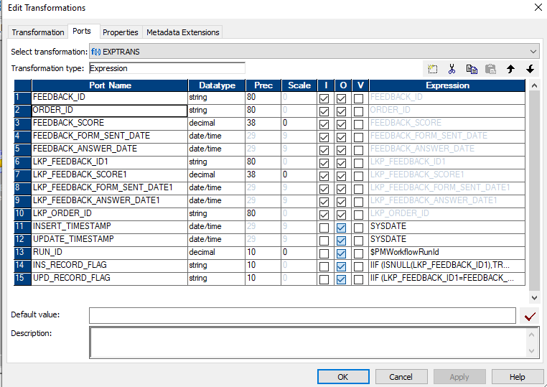
Transformations Applied
Expression Transformation

Slide 49
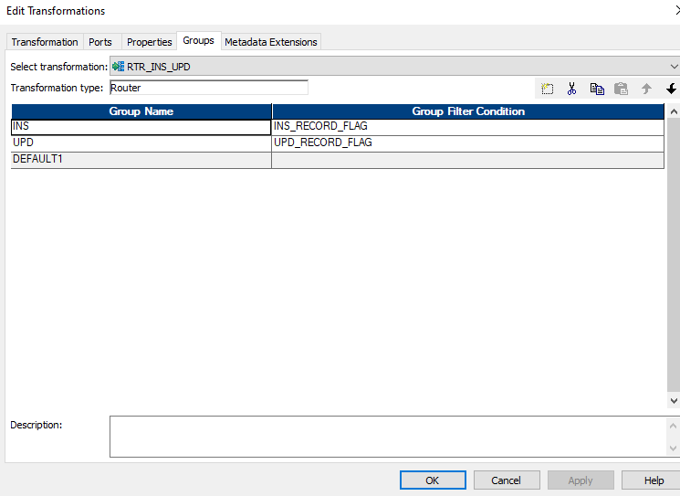
ROUTER Transformation

Slide 50
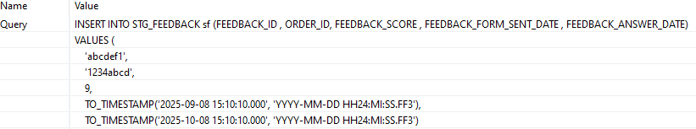
SCD Type 1 Verification Process(DIM_FEEDBACK)
Step 1: Insert a New Record into STG_FEEDBACK

Slide 51
Step 2: Run the Informatica Workflow
Step 3: Verify Data in DIM_FEEDBACK Table

Slide 52

Step 4: Update the Record in STG_FEEDBACK

Slide 53
Step 5: Re-run the Informatica Workflow
Step 6: Verify the Update in DIM_FEEDBACK

Slide 54
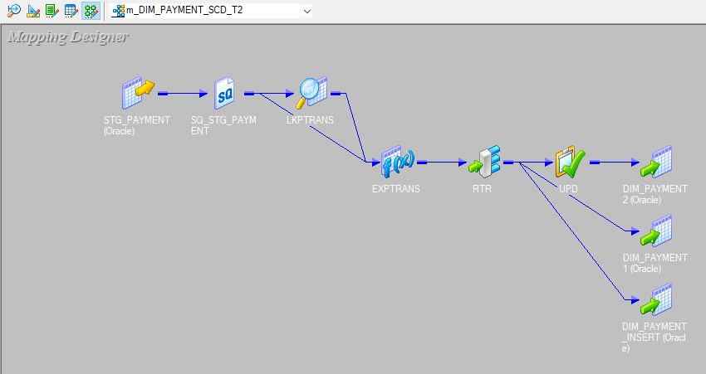
1. Mapping Overview(DIM_PAYMENT)
Mapping Name: [m_DIM_PAYMENT_SCD_T2]
Source Table: [STG_PAYMENT]
Target Table: [DIM_PAYMENT]

Slide 55
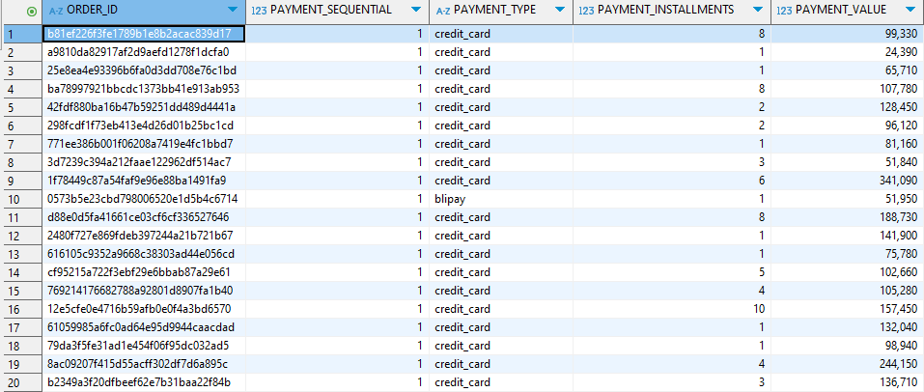
2. Source (Staging Table) Details
Table Name: [STG_PAYMENT]

Slide 56
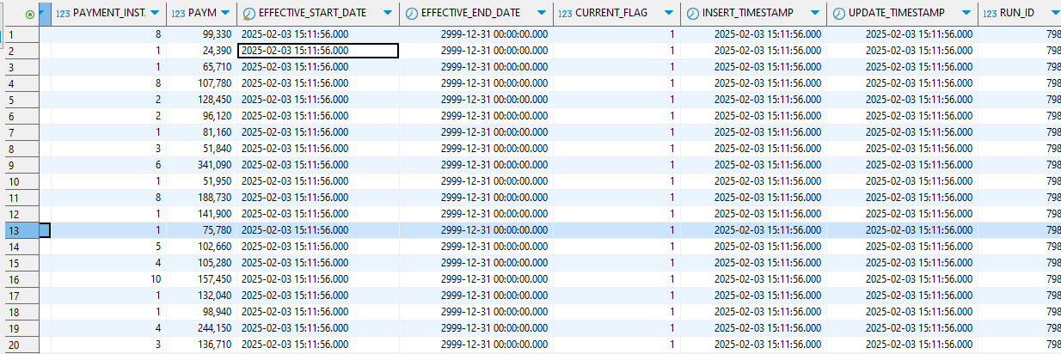
3. Target (Data Warehouse Table) Details
Table Name: [DIM_PAYMENT]
Table Type: [Dimension Table]

Slide 57
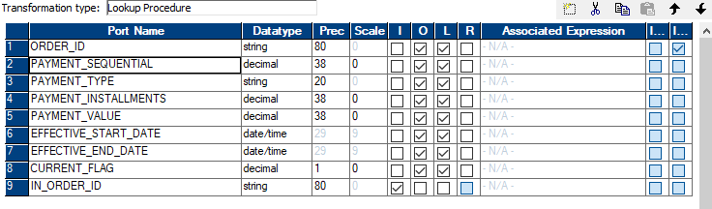
Transformations Applied
Lookup Transformation;

Slide 58
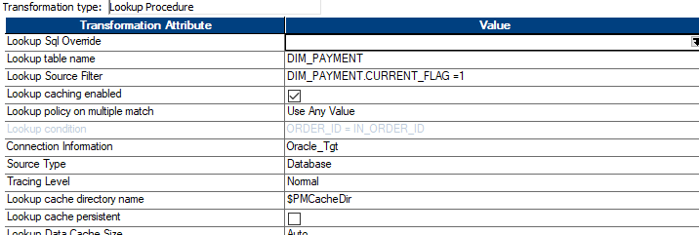

Slide 59
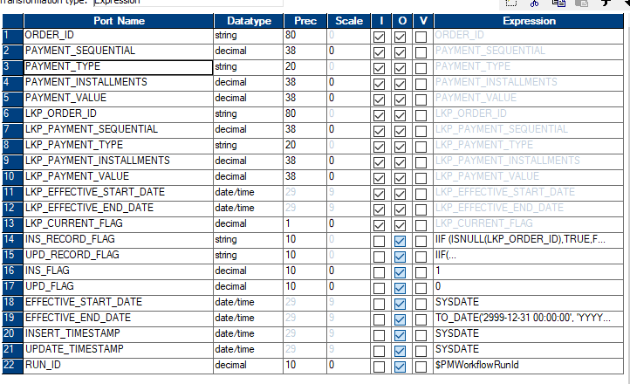
Expression Transformation:

Slide 60
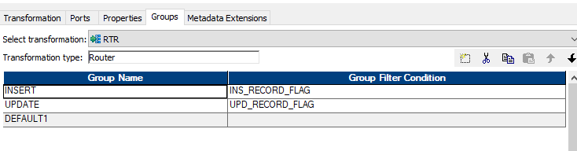
ROUTER Transformation

Slide 61
SCD Type 2 Verification Process(DIM_PAYMENT
Step 1: Insert a New Record into STG_PAYMENT

Slide 62
Step 2: Run the Informatica Workflow
Step 3: Verify Data in DIM_PAYMENT Table

Slide 63

Step 4: Update the Record in STG_PAYMENT

Slide 64
Step 5: Re-run the Informatica Workflow
Step 6: Verify the Update in DIM_PAYMENT

Slide 65
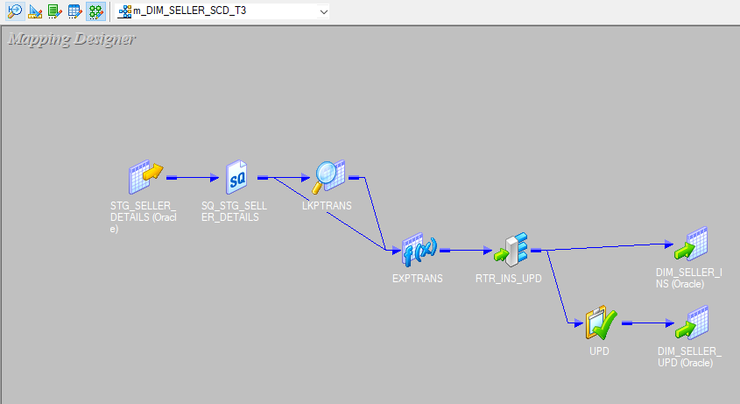
1. Mapping Overview(DIM_SELLER)
Mapping Name: [m_DIM_SELLER_SCD_T3]
Source Table: [STG_SELLER_DETAILS]
Target Table: [DIM_SELLER]

Slide 66
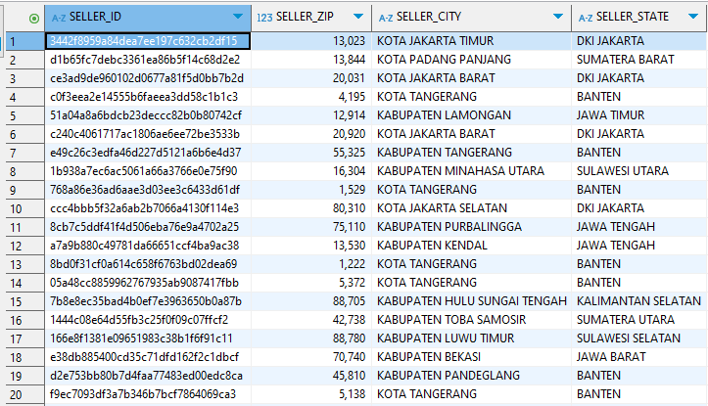
2. Source (Staging Table) Details
Table Name: [STG_SELLER_DETAILS]

Slide 67
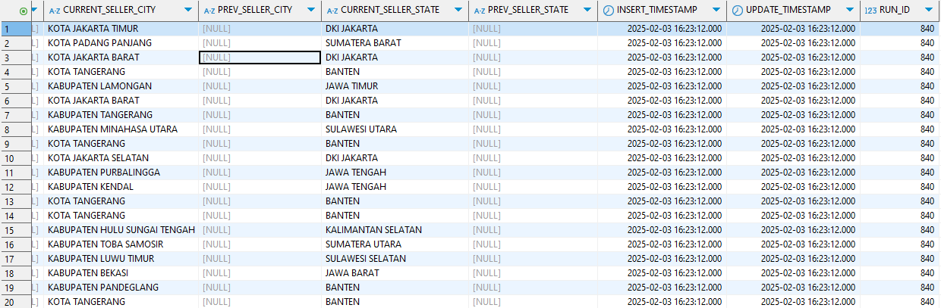
3. Target (Data Warehouse Table) Details
Table Name: [DIM_SELLER]
Table Type: [Dimension]

Slide 68
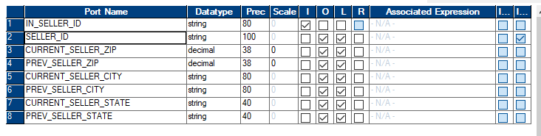
Transformations Applied
Lookup Transformation

Slide 69
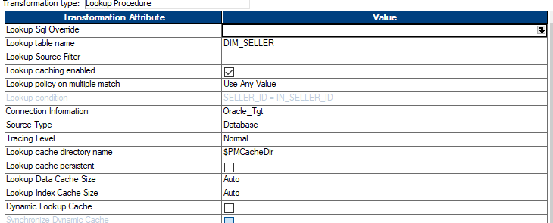

Slide 70
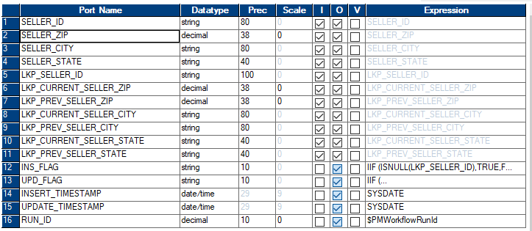
Expression Transformation

Slide 71
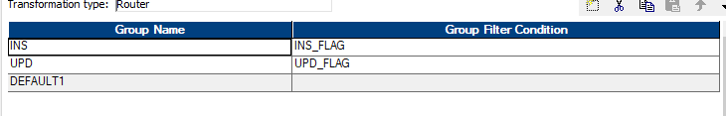
ROUTER Transformation:

Slide 72

SCD Type 3 Verification Process(DIM_SELLER)
Step 1: Insert a New Record into STG_SELLER_DETAILS

Slide 73
Step 2: Run the Informatica Workflow
Step 3: Verify Data in DIM_SELLER Table

Slide 74
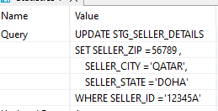
Step 4: Update the Record in STG_SELLER_DETAILS

Slide 75
Step 5: Re-run the Informatica Workflow
Step 6: Verify the Update in DIM_SELLER

Slide 76
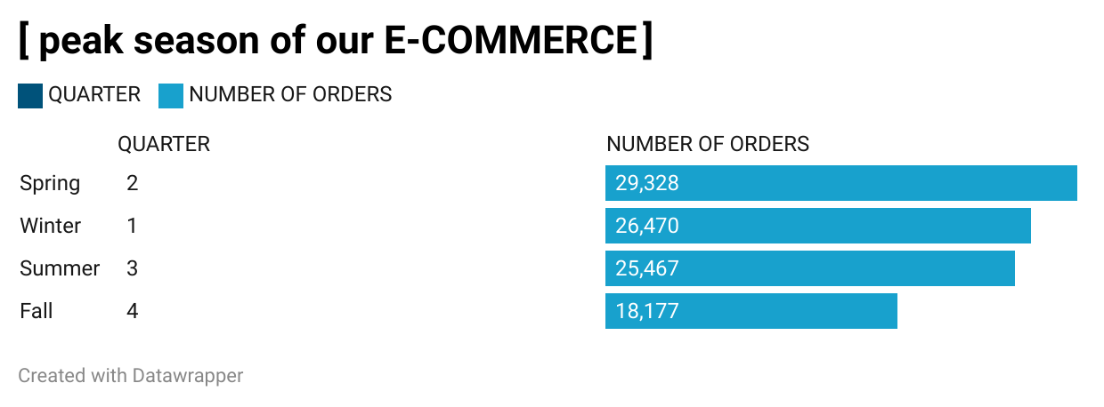

Slide 77
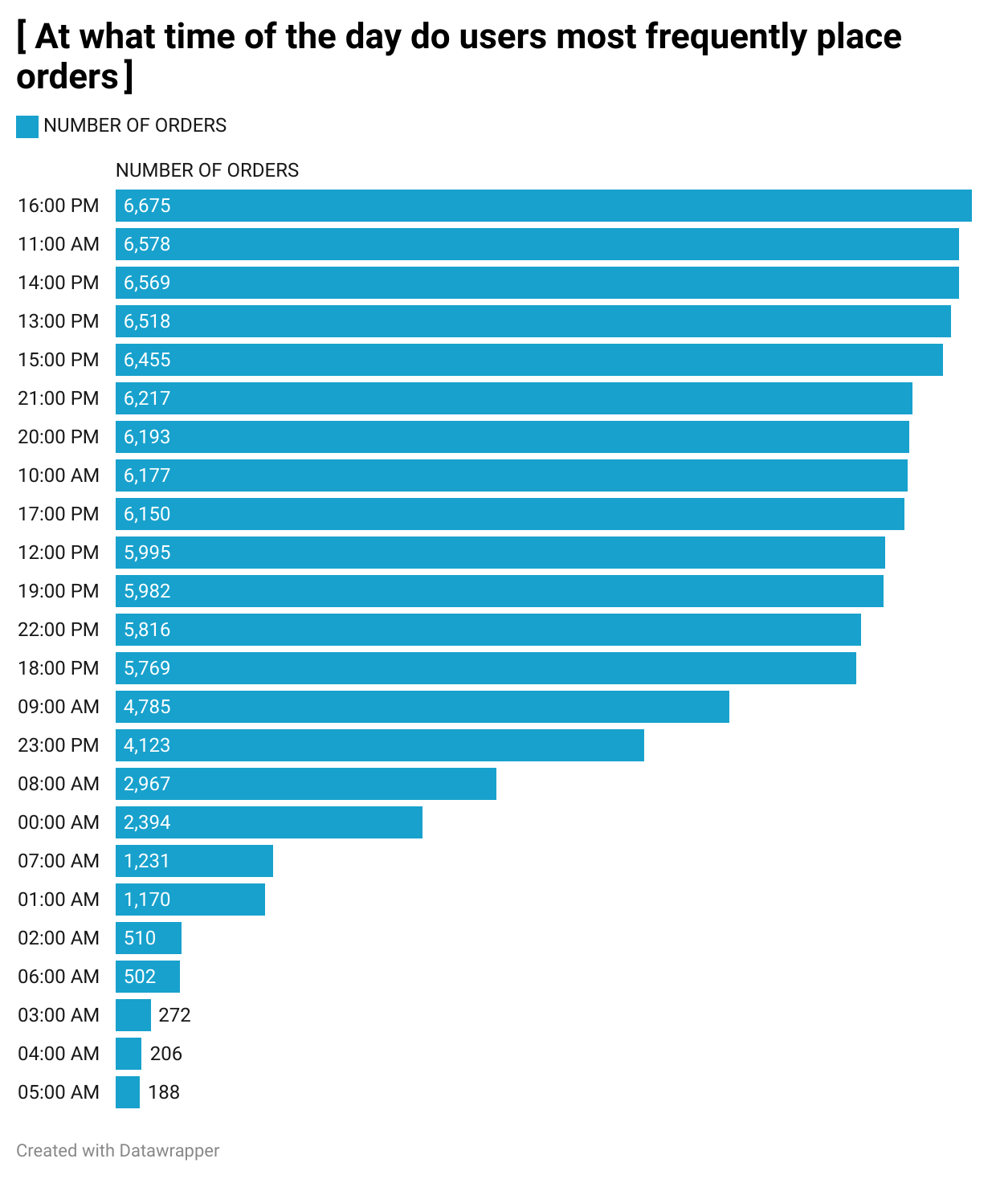

Slide 78
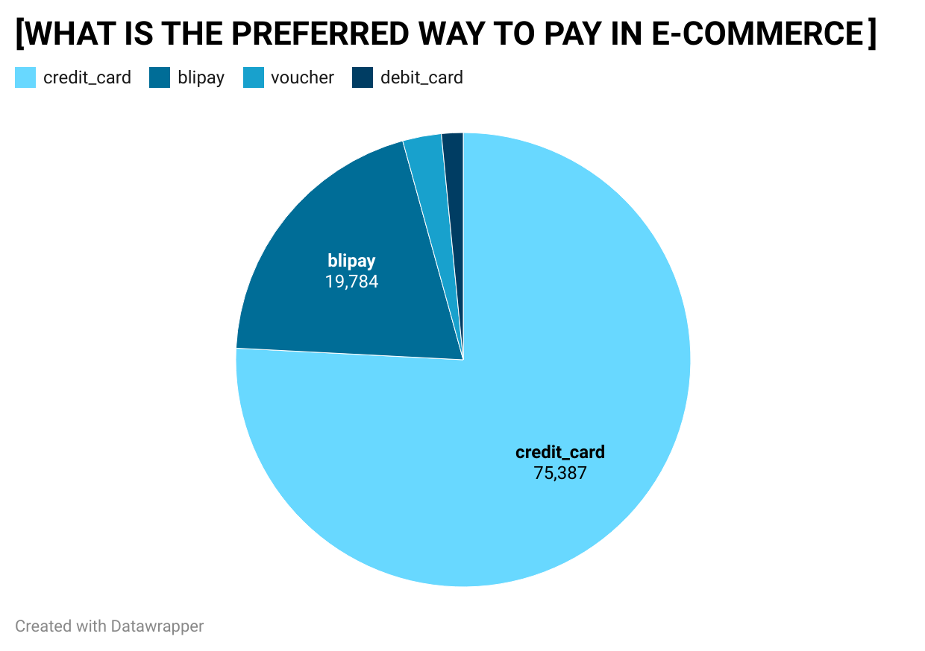

Slide 79
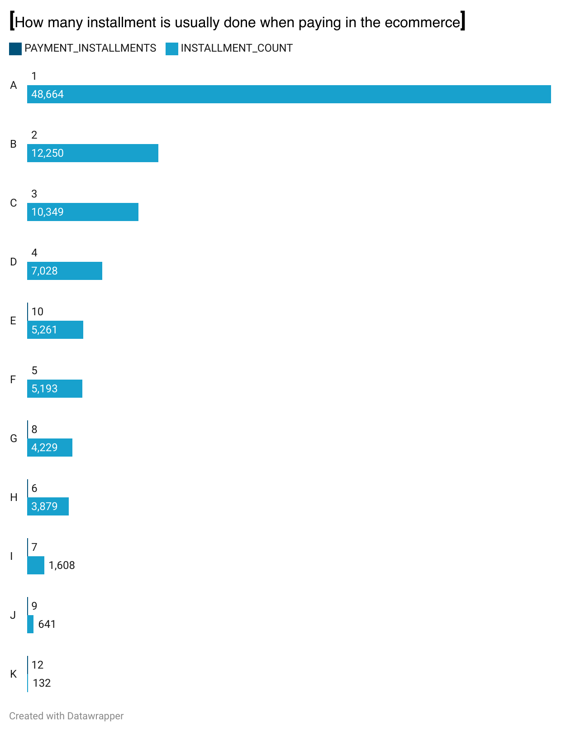

Slide 80
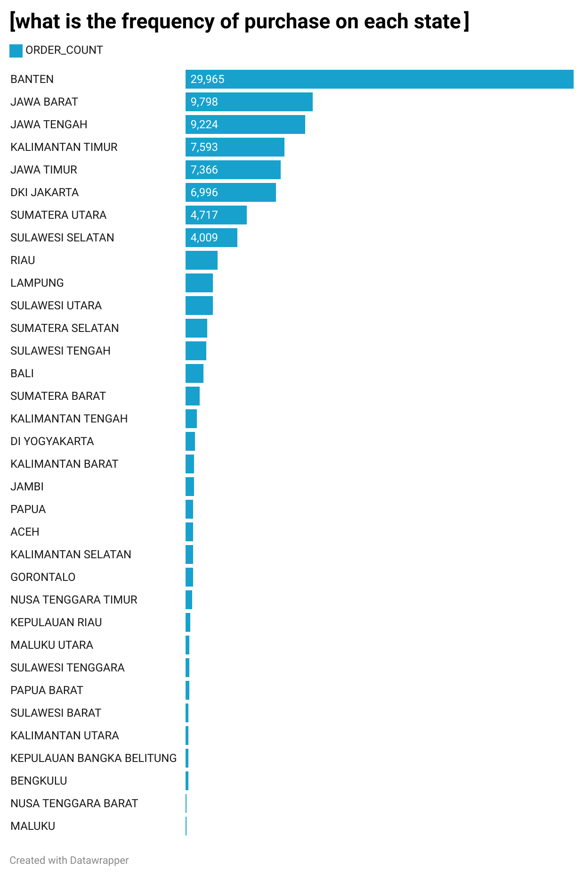

Slide 81
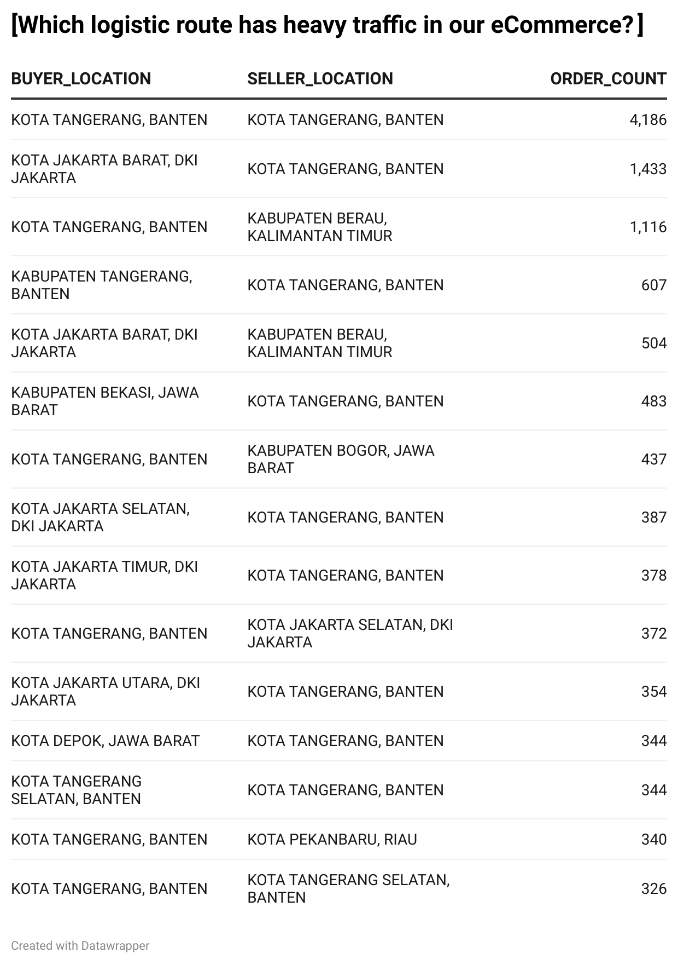

Slide 82
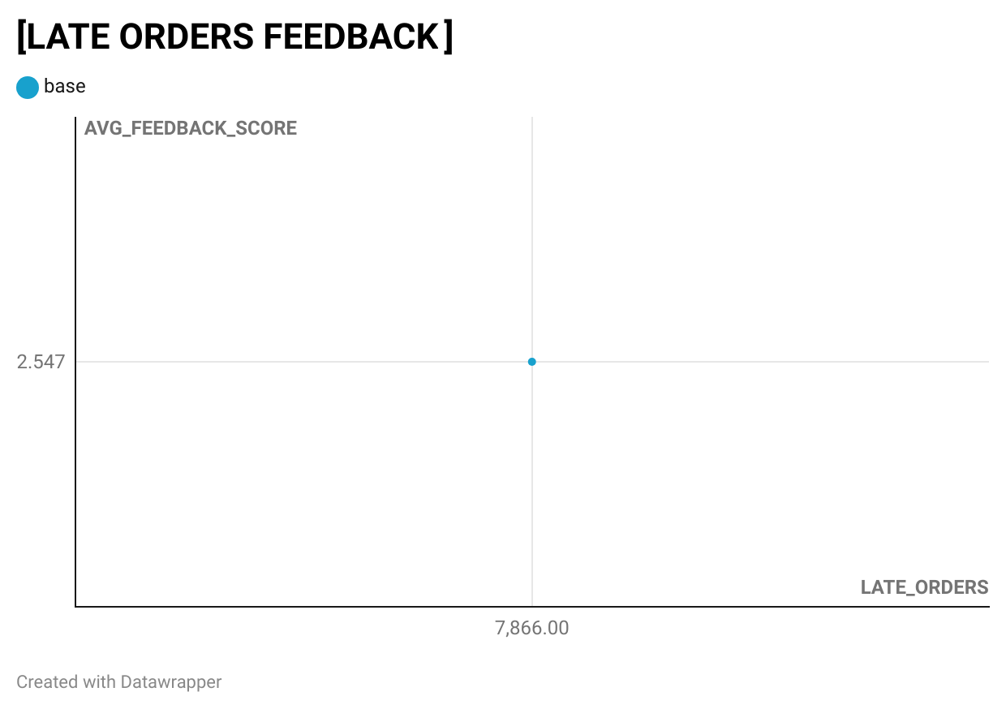

Slide 83
